Slide 1

Physiological Impacts of Firefighting

Slide 2
Class Overview
Cardiovascular System
Hydration
Core Temperature
CO and HCN Exposure

Slide 3
Data
CPFR-Victim Rescue Drill: April 2011
OCFA-Safety and Performance Implications: December 2007
ErgoFit-FF Complete Cardio Training: November 2010
New England JOM-Heart Disease and Firefighters: March 2007

Slide 4
Cardiovascular System
45% of FF Deaths Cardiac Events
  Majority attributed to CHD
    Coronary Arteries become damaged or diseased due to plaque buildup.
  Some Risk Factors
    Hypertension, Physical Inactivity, Obesity
  “CHD death is significantly higher during fire suppression, responding to alarms and certain physical activities” New England JOM
    fires: 1%-5% of time= 1/3 of coronary events

Slide 5
System Impacts
Significant stress to system
  Donning: PPE 50 bpm increase
  Tones: 170 bpm
  Firefighting Tasks: HR 160-200 bpm
  Dehydration
  Elevated Core Temperature

Slide 6
Firefighter Testing Data
CPFR 5min. Single Victim Rescue OCFA (2) 15min. Fire Attack Drills | Participants 122 Participants 101
Firefighter Average Age | CPFR 40.5 OCFA 39.5
Maximum Heart Rate Avg. | CPFR 173 (150-194) OCFA 180
Rate of Perceived Exertion 1-10 Average Fitness Level 1-7 | CPFR 8.2 OCFA 3.3

Slide 7
Recommendations
Effective Cardio Training
  Why?
    Decreases Cardiovascular Risk Factors (CHD,BP,wt.)
    Increased VO2 Max= last longer
    Decreases recovery time= better performance
    Increases cal. burning (wt. control)
    Lower resting HR (less stress on system)
    FIRE FIT= 15min. 160-200bpm

Slide 8
Recommendations Cont.
Effective Cardio Training
  How
    By developing three zones
      Zone 3: Peak Interval Training=intense work
        86%-90% MHR ( 1-2 words)
      Zone 2: Anaerobic Threshold=medium intensity
        76%-85% MHR ( 1 sentence)
      Zone 1: Foundation/Recovery=light work
        60%-75% MHR (conversation)

Slide 9
Comparison
 | ZONE 1 | ZONE 2 | ZONE 3
% MHR | 60%-75% (220-age) | 76%-85% | 86%-90%
Descriptors | Light, RPE 4-5, Conversation | Medium, RPE 6-8, Sentence | Hard, RPE 9-10, 1-2 words
Frequency | 2-3/wk. then move to Zone 2. | 1-2/wk. then move 2-4/wk. | 1/wk. then move 2/wk. diff. days
Intervals | None | In Zone 2 Recover Zone1 | In Zone 2 and 3 Recover 1-2
Sustained | Build up to 30-40 | Build up 30-40 | 3-4x for 30sec.
When to Progress | 30-40min. 2 wks. | 30-40min. 2 wks. Introduce Zone 3 intervals | Able to stay in Zone 2 after Zone 3 intervals, Add more

Slide 10
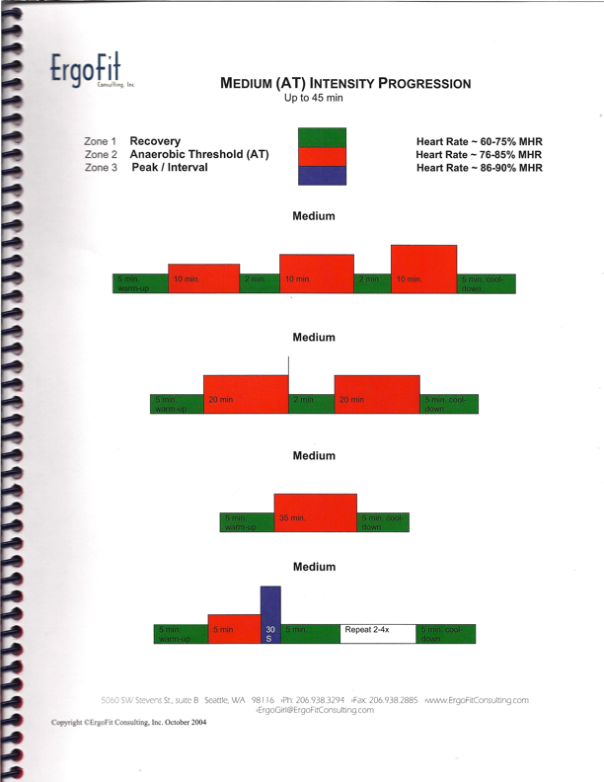
Sample Workout

Slide 11
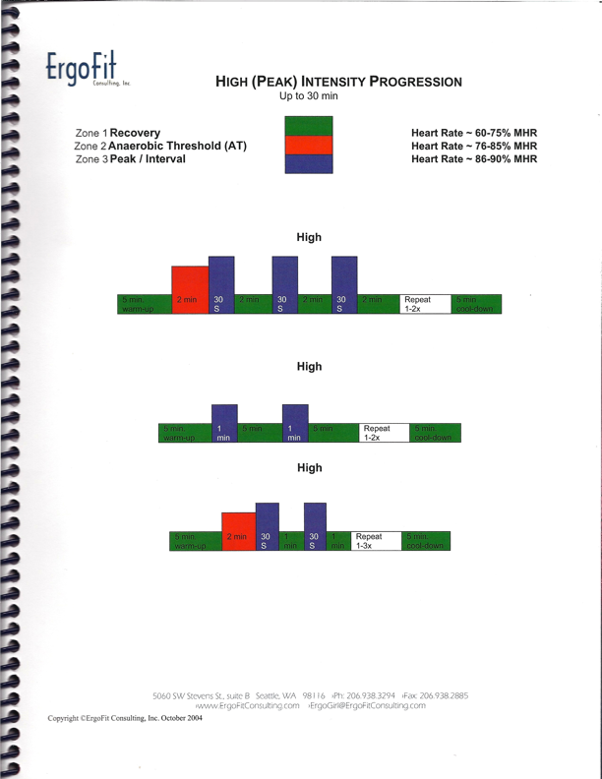
Sample Workout

Slide 12
Sample Workouts
FIRE FIT
  Developed by PFT’s
  10 workouts/month (variety)
  Flexibility, mobility, strength vs. cardio only
  Job Specific Intensity & Movements

Slide 13
Hydration Status
Dehydration-reduction in body’s water content and a loss of important salts and minerals necessary for proper function.
Crucial for FF- due to extreme dehydration risk factors.
  Strenuous physical activity
  Exposure to high temps
  Use of heavy clothing

Slide 14
Dehydration Impacts
Can cause-
  Increased body temp. and fatigue
  Decreased BP, vision, strength, mental ability
Can lead to- heat cramps, exhaustion, stroke, death

Slide 15
Hydration Data
Hydration Status | Specific Gravity of Urine | Number of Participants | Percentage of Participants
Well Hydrated | Under 1.010 | 19 | CPFR 19% OCFA 9%
Minimally Dehydrated | 1.010-1.020 | 59 | CPFR 60% OCFA 65%
Significantly Dehydrated | 1.020-1.030 | 19 | CPFR 19% OCFA 22%
Seriously Dehydrated | Over 1.030 | 1 | CPFR 1% OCFA 4%

Slide 16
Recommendations
Come to work hydrated
Day of Drinking= Dehydration & Mineral loss
Clear Urine= good (multivit. can impact)
3 liters H2O/180lb. FF =well hydrated
Follow Rehab Policy #427(link to new policy)
  Review Rehab Eval. Process
  Review FF Rehab Data Sheet

Slide 17
Core Body Temperature
98.6 Normal Temp.
No uniform standard for high core temp.
World Health Org.= below 100.4F
English Study: London Fire= below 103.1F
Other research= below 104F

Slide 18
Core Temp. Impacts
Heat Exhaustion
  Nausea, vomiting, rapid breathing, heavy sweating
Heat Stroke
  Temp. greater than 105F
  Lack of sweating, confusion, agitation, seizure,coma

Slide 19
Data
CPFR drill
  Tympanic, Oral, Temporal devices all gave inaccurate readings
OCFA study
  core temp. highest 10 min. in rehab
  92% had between 1-3% body wt. fluid loss
    Elevated HR, Decreased BP, High Fatigue

Slide 20
OCFA Data
Time of Reading | Avg. Core Temp. w/ingested capsule | Avg. Temp. Tympanic | Difference in Fahrenheit
5 min. of rest | 101.8 | 100.3 | 1.5
10min. of rest | 102.0 | 99.2 | 2.8
15min. of rest | 101.6 | 98.2 | 3.4
20min. of rest | 101.1 | 98.0 | 3.1

Slide 21
Recommendations
Be aware of inaccurate temperatures
Pay attention to FF’s at Rehab
Rotate Crews Proactively
Encourage them to take off jacket
OCFA-tested 4 methods of cooling
  Towels, ambient air, misting fan, cooling chair
Best Method=Wet Towels

Slide 22
CO &HCN Exposure
Rapid Growth in Plastics in Structures
Synthetic Polymers=CO & HCN
Fires burn 2-3x hotter=increased release HCN
4 gas monitors don’t pick up HCN or many plastics.
Off gassing high post fire

Slide 23
Impacts
Symptoms can be immediate/delayed
  Lethargy, disoriented, resp. diff., chest pn., headache, dysrhythmia, bright red skin
Permanent Organ Damage
CO displaces O2 in body bonds to hemoglobin
Strong evidence source of many Cancers
  Cause of Presumptive Cancer Legislation

Slide 24
Recommendations
Follow Policy #424 “Full SCBA shall be worn during overhaul operations”
Use fresh crews due to SCBA fatigue
Electric fan for air movement
Wash PPE
  Gloves and hood on small fires
  Helmet to boots on working fire

Slide 25
CPFR Wellness Fitness
For US=Internal Customer Service
We need your input and Commitment
Department is Committed
  Officers ensure PT is provided
  Officers need to be role models
  Common Sense w/PT clothing
  Quarterly Classes starting soon (watch for e-mail)

